Slide 1

Electric Water Heater System

Slide 2
Team members
ZYAD WALED ELBRDAN

Slide 3
agenda
Introduction
Features and Specifications
System Design
Flowchart
Workflow

Slide 4
Introduction
Objective: Design and implement an electric water heater with the following functionalities:
Temperature setting and control.
ON/OFF behavior management.
Accurate temperature sensing.
Automated heating and cooling element control.
User-friendly display using seven-segment indicators.
Indicator LED for heating status.

Slide 5
Features and Specifications
1. Temperature Setting
"Up" and "Down" buttons adjust the required water temperature.
First button press activates temperature setting mode.
Temperature adjustments:
"Up" increases by 5°C (max: 75°C).
"Down" decreases by 5°C (min: 35°C).
Temperature is saved to external EEPROM.
Automatically exits setting mode after 5 seconds of inactivity.
Default temperature: 60°C.

Slide 6
Features and Specifications
2. ON/OFF Behavior
"Initial state: OFF when power is connected.
Toggle ON/OFF using the "ON/OFF" button.
In OFF state:
Heater components and displays are disabled.

Slide 7
Features and Specifications
3. Temperature Sensing
Measures water temperature every 100ms.
Maintains average of the last 10 readings.
Accurate sensing for decision-making.

Slide 8
Features and Specifications
4. Heating and Cooling Element Control
Heating Element:
ON: Current temperature < Set temperature - 5°C.
OFF: Current temperature > Set temperature + 5°C.
Cooling Element:
OFF: Current temperature < Set temperature - 5°C.
ON: Current temperature > Set temperature + 5°C.

Slide 9
Features and Specifications
5. Seven-Segment Display
Default: Displays current water temperature.
Temperature setting mode:
Displays set temperature.
Blinks every 1 second.
Exits mode if no buttons are pressed for 5 seconds.

Slide 10
Features and Specifications
6. Heating Element LEDs
Heating led Blinks every 1 second when heating element is ON.
Cooling led Remains ON if cooling element is active.
Booth leds OFF if the temperature is prefect or the system is off

Slide 11

System Design

Slide 12
Hardware Components
Microcontroller: ATMEGA32.
Temperature Sensor: Measures water temperature.
EEPROM: for storing set temperature.
Seven-Segment Display: Shows current/set temperature.
Heating and Cooling Elements: Regulate water temperature.
LED Indicator: Displays heating status.

Slide 13
Software Modules
HAL (Hardware Abstraction Layer):
The HAL provides an interface for hardware components. It abstracts the hardware specifics, making the system more modular and scalable.
Key modules in the HAL include:
Buttons: Handles button press detection and debouncing.
EEPROM: Interfaces with the 24C16B for reading and writing set temperature data.
Seven-Segment Display: Manages the display of temperature values, including blinking behavior.
LEDs: Controls the status indication of heating and cooling operations.
LM35: Temperature sensor used to get the water temperature .
MCAL (Microcontroller Abstraction Layer):
The MCAL provides low-level drivers for the ATMEGA32 microcontroller. It ensures efficient and reliable hardware operation.
Key drivers in the MCAL include:
GPIO (General Purpose Input/Output): Configures and controls digital I/O pins.
Timers: Used for periodic tasks such as temperature sensing and LED blinking.
ADC (Analog-to-Digital Converter): Reads analog data from the temperature sensor and converts it to a digital format.
I2C Protocol: Implements communication protocols for interfacing with the external EEPROM.

Slide 14
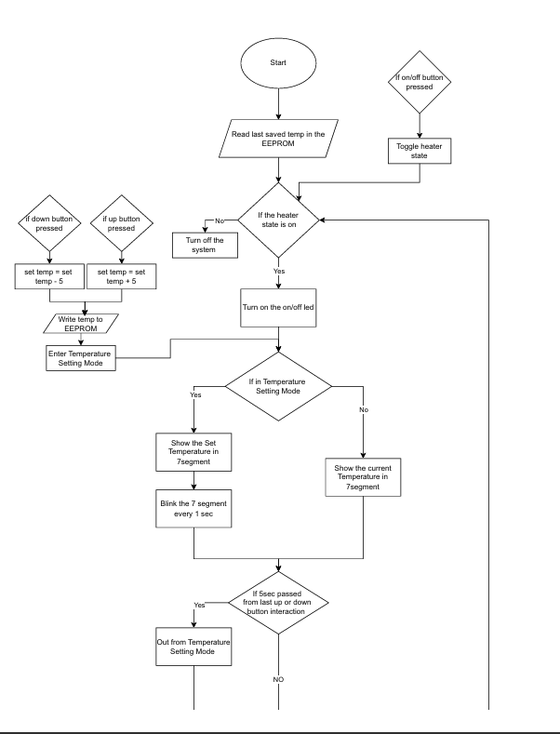
Flowchart

Slide 15
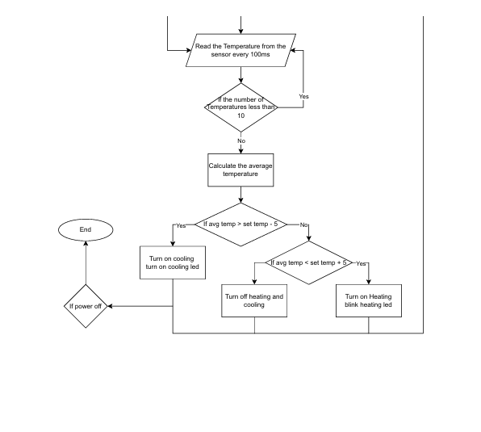
Flowchart

Slide 16
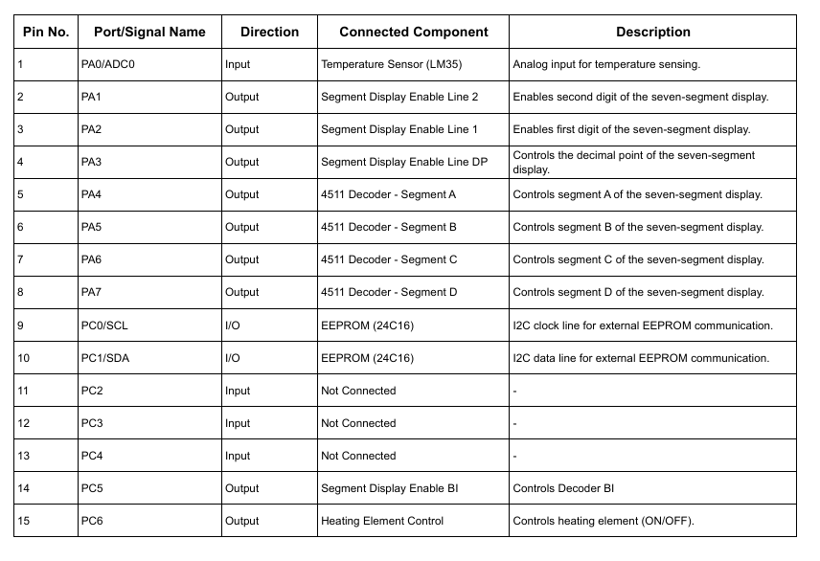
IO List

Slide 17
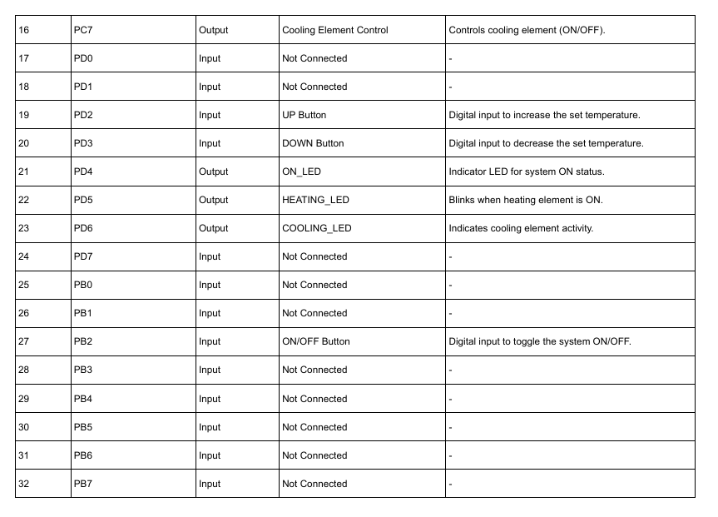
IO List

Slide 18
Workflow
Power ON: System initializes in OFF state.
User toggles ON state:
Current water temperature displayed.
Heating or cooling elements activated based on temperature.
User adjusts temperature:
"Up" and "Down" buttons change settings.
EEPROM saves new set temperature.
Real-time temperature sensing:
Ensures water remains within desired range.
Heating and cooling elements respond dynamically.
Visual feedback:
Seven-segment display for temperature.
LED indicator for heating status.

Slide 19
Component Used
1. 24C08EEPROM.
2. Tempsensor(LM35).
3. CoolingElement.
4. HeatingElement.
5. 7-segments.
6. LEDs.
7. PushButtons.
8. SolidState Relays

Slide 20

Thank you
Zyad Waled

